Slide 1
Zscaler Deployment

Slide 2
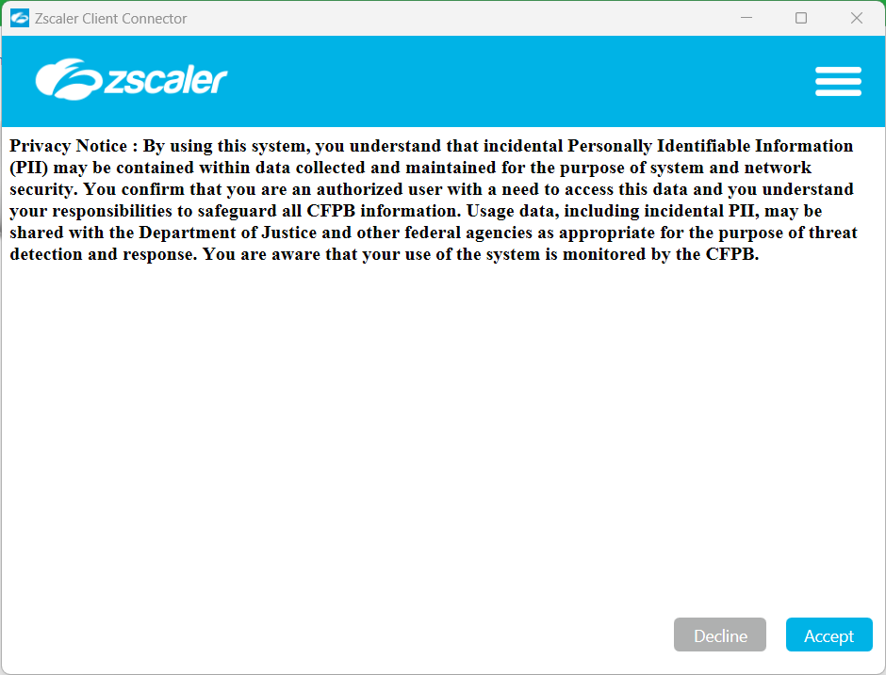
What to Expect – For Windows Users
The deployment process will begin on August 22. At 4pm ET, Zscaler will become available on your device.
Zscaler will open automatically, and a welcome pop-up will appear. Click Accept.
Note: Your network will briefly disconnect. It will reconnect once you hit Accept.
1
Notes:
Speaker: Ali Sadeghi
​
Talking Points:​
So, let’s talk about what the process will look like for Windows and Mac users
For Windows users, at 4:00pm ET, Zscaler will be installed on your computer.
For most machines, it'll install immediately at 4pm. But if a laptop has another installation happening, or a pending reboot, it'll happen later.
The Zscaler client will launch automatically, and you will see a welcome pop-up.
When you connect to Zscaler, you’ll disconnect from Cisco AnyConnect. This may cause a brief network disconnect.
Click the accept button to log in.
Once you have successfully connected to Zscaler the first time, you will not need to go through this process again.
Are there any questions for Windows users?
Megan: Navigate to next slide​

Slide 3
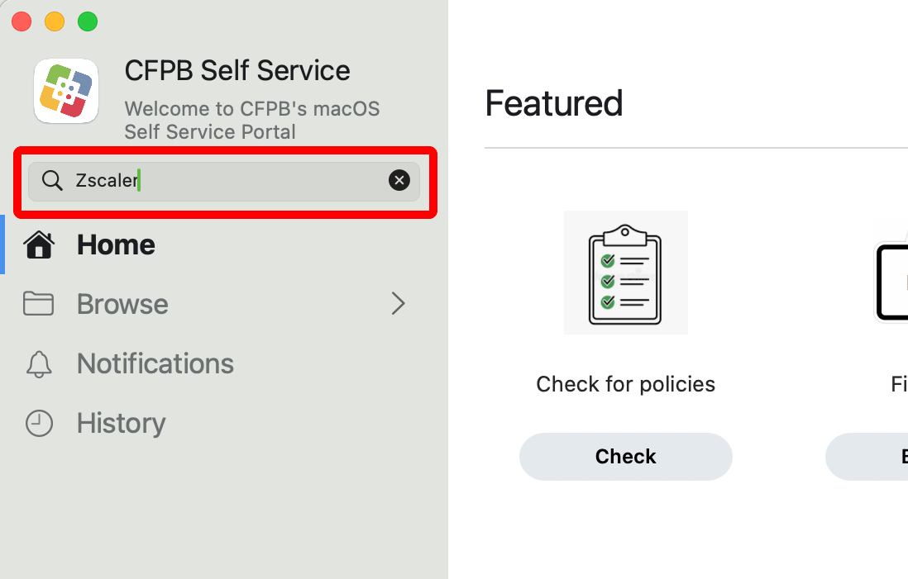
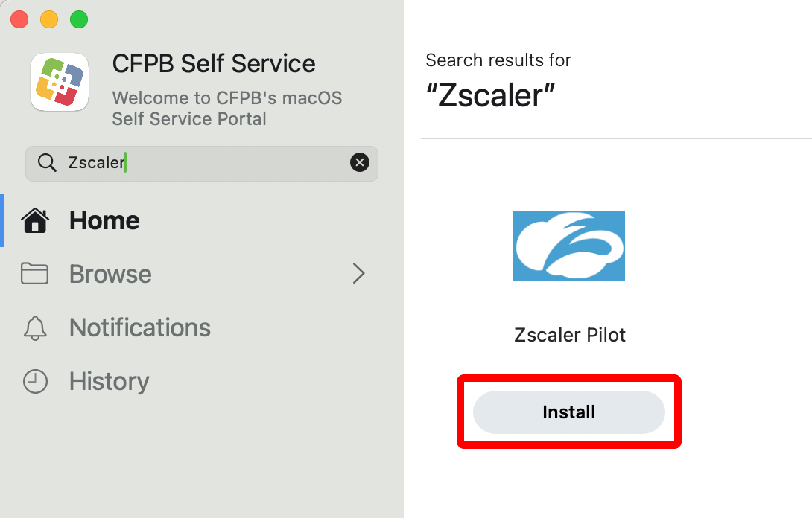
What to Expect – For Mac Users
By 11am ET on August 22, Zscaler will become available on your device.
Open Self Service and search for Zscaler.
Click Install.
1
2
Notes:
Speaker: Ali Sadeghi
​
Talking Points:​
If you are a Mac user, or you have folks in your organization who are Mac users, your experience will be a little different. The process is slightly different, with a few additional steps that you will need to take.
By 11am ET on Thursday, Zscaler will become available on your computer, however, you will need to initiate the installation process. A Zscaler installation reminder to do this will pop up.
To begin the installation, open Self Service through Settings, and search for Zscaler.
When Zscaler shows, click Install.
The images on this slide help depict this portion of the process.
Megan: Navigate to next slide​

Slide 4
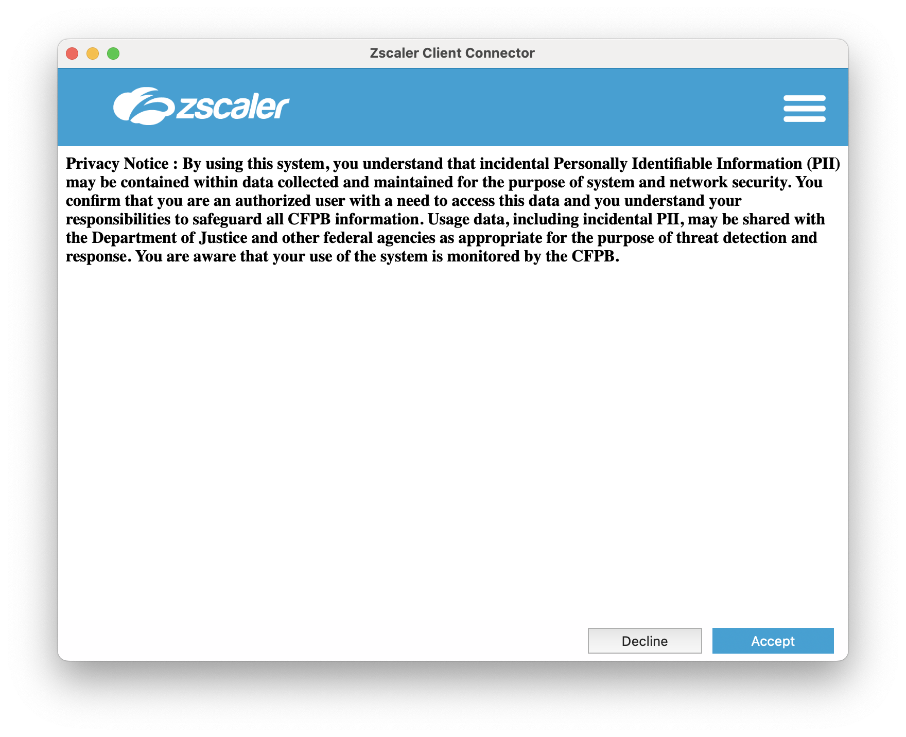
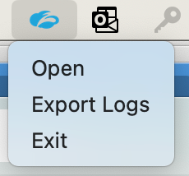
What to Expect – For Mac Users
Insert your PIV card or YubiKey.
Open Zscaler from the menu bar.
Accept CFPB Terms.
4
5
Notes:
Speaker: Ali Sadeghi
​
Talking Points:​
Installation may take approximately 30 seconds or so – you may see the loading (spinning) circle
Your connection will drop until you connect to Zscaler, so please do this at a time that works for you – you should not do this during a Teams meeting for example.
Ensure that your PIV card and YubiKey are inserted, as this is required for you to be able to authenticate to Microsoft.
Then open Zscaler from the menu bar, as depicted in step 4.
Once it opens, accept the CFPB terms.
Megan: Navigate to next slide​

Slide 5
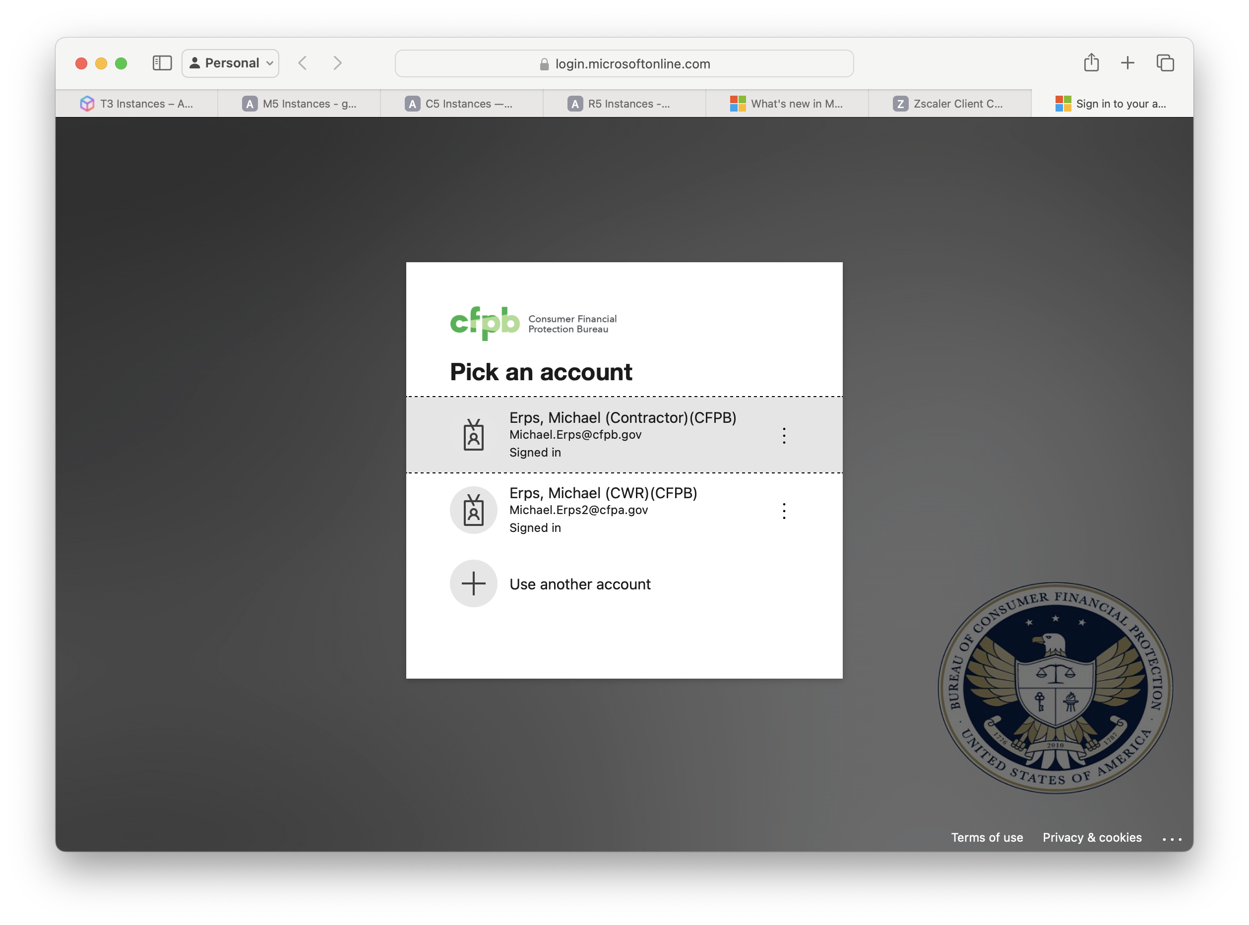
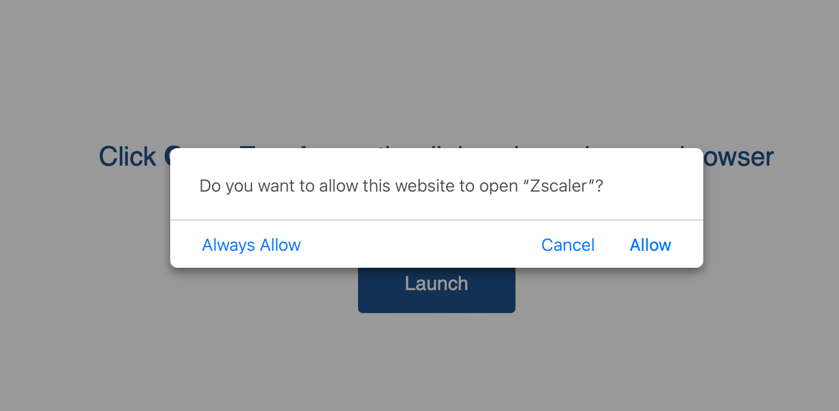
What to Expect – For Mac Users
Safari will open. Enter PIV pin or YubiKey credential.
Safari may open a second time asking for authentication. Enter PIV pin or YubiKey credential, if prompted.
Select Allow when prompted “Do you want to allow this website to open Zscaler?“
Notes:
Speaker: Ali Sadeghi
​
Talking Points:​
Once you have accepted, Zscaler’s app will open to begin registering your device.
Safari should automatically open, asking for authentication. You will authenticate by entering your PIV pin or YubiKey credential
You will have to authenticate Zscaler 2 times.
After you enter your credentials the first time, Safari will open again and ask for authentication. If prompted, please enter your PIV pin or YubiKey credential again.
Select Allow when prompted “Do you want to allow this website to open Zscaler?“
Megan: Navigate to next slide​
and then will be asked to authenticate to Zscaler, or Zscaler will be added to your menu

Slide 6
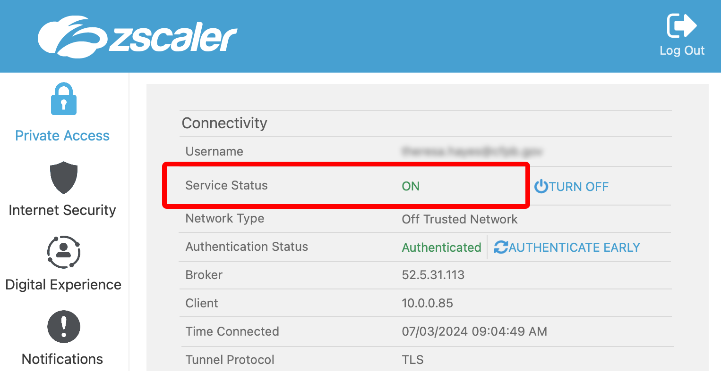
What to Expect – For Mac Users
Verify Zscaler is connected by opening the Zscaler app from the menu bar. Private Access and Internet Security should show Service Status ON.
Note: The Cisco AnyConnect app will automatically be removed from your system.
Notes:
Speaker: Ali Sadeghi
​
Talking Points:​
You should then open the Zscaler app from the menu bar to verify that Zscaler is connected. In the app you should see Private Access and Internet Security are showing as Service Status ON.
Although there are a few more steps for Mac users, in the last pilot, there were no concerns from the testers regarding the installation.
Once you have successfully connected to Zscaler the first time, you will not need to go through this process again.
Are there any questions for Mac users?
Megan: Navigate to next slide​

Slide 7
Resources
Installation guide for Macs
Zscaler Wiki page
Zscaler – Pathfinders Teams Channel
Notes:
Speaker: Megan Luten
​
Talking Points:​
The team has developed a few resources for you to access throughout the process.
The Mac installation guide will be provided directly to Mac users, but can also be accessed through this link.
We also have a Zscaler Wiki page with information about Zscaler, FAQs, and additional resources.
These links as well as this deck will be available in the T&I Pathfinders Network Team in the dedicated Zscaler channel.
As a reminder, the Teams channel can be used to post feedback, questions, and discussion with the group, however, issues or anything you need help with should be submitted in a ticket through the Service Desk.
Megan: Navigate to next slide​

